Slide 1
TESTING E-COMMERCE PRODUTOSBRASILEIROS.CO.UK
1st Challenge Mentoria 2.0
Amanda Rodrigues
Francielle Glauzer
Luana Clementino
Luiz Gustavo Gomes
Rafael Petenuci

Slide 2
ABOUT THE WEBSITE UNDER TEST
Website Name: Produtos Brasileiro Website URL: produtosbrasileiros.co.uk
Type: Brazilian grocery e-commerce platform
Description: This website is an online store that offers a wide range of Brazilian food products and household items to customers living in the United Kingdom (especially the Brazilian community in London).

Slide 3
PROMPT USED IN CHATGPT
Objective: Use Bach's mindset to list tests that I could perform on a website to identify defects.
Context:
James Bach's testing mindset is that the tester is someone with critical thinking, focused on analyzing, understanding, and learning from the object of their tests.
Rules: Focus only on Bach's view, do not use the mindset of other testers.
Example: Enter text with many characters in the site's search box to see how the application handles it.
Format: List of tests with numeric identifier and a brief summary of the recommended test.

Slide 4

REFERENCE: JAMES BACH
Using James Bach's mindset:
James Bach's testing mindset is that the tester is someone with critical thinking, focused on analyzing, understanding, and learning from the object of their tests.

Slide 5
FIRST LIST GENERATED BY CHATGPT
Search with excessive characters Enter 500+ characters in the search box to observe limits, performance, and error messages.
Search with special characters Search using unusual symbols (%$, ; <script>) to see if the system filters them or produces unexpected errors.
Search with no results Search for something nonexistent (“asdfgh12345”) to evaluate clarity of feedback.
Language switching Check if all texts change correctly between PT/EN, or if some remain inconsistent.

Slide 6
FIRST LIST GENERATED BY CHATGPT
Repeated item addition Insert the same product multiple times quickly and check if the cart duplicates correctly or creates inconsistency.
Login Try logging in with invalid credentials (wrong password, non-existent email) and observe messages.
Phone formatting Test WhatsApp contact with numbers in different formats (with/without country code).
Free delivery Simulate purchases close to £70 (69.99, 70.00, 70.01) to verify if the shipping rule works exactly as advertised.
Customer service hours Send a message outside support hours (after 6pm) and observe automated response or failure.

Slide 7
FIRST LIST GENERATED BY CHATGPT
Main Links Click menus (“Meat”, “Groceries”, etc.) and verify if they lead to the correct categories.
Promotions (Offers/Favorites) Click “Confira” and check if it opens products or just static banners.
Empty cart Access the cart without adding anything to see if a friendly message appears or if it errors out.
Expired session Add items to the cart, wait without interaction, and verify if the session expires correctly.
Mobile access Use reduced screen (inspect in mobile mode) to validate if banners, buttons, and menus adjust
“Get our app today!” button Click and confirm if it leads to the correct app store or generates an error.

Slide 8
SECOND LIST GENERATED BY CHATGPT
Large amount of text in the search field Enter a very long string or special characters in the search field (if available) to observe how the system handles excessive input, potential errors, or performance slowdown.
Navigation across categories and subcategories Sequentially explore categories such as Meat, Grocery, Frozen — click on each one and verify whether loading, displayed items, and ordering are correct (e.g., Picanha, Beans, etc.).
Behavior when adding items to the cart Add items to the shopping cart and verify whether quantities are correct, subtotals are updated properly, and how the site reacts when multiple units or different products are added.

Slide 9
SECOND LIST GENERATED BY CHATGPT
Boundary testing on the cart Insert a very large quantity (e.g., 999 or more) of the same product to verify validation, price calculation accuracy, stock limits, or potential crashes.
Login/account flow (“Sign in”) Attempt to log in with invalid credentials or non-existent accounts. Observe error messages and security behavior (e.g., lockout time after multiple failed attempts).
Contact form submission On the contact page (via Contact Us or equivalent), submit forms with incomplete inputs, special characters, or without filling mandatory fields. Verify field validation and user feedback.

Slide 10
SECOND LIST GENERATED BY CHATGPT
Responsive elements and banner/promo navigation Explore promotional banners or carousels (e.g., about the app or giveaways). Test clicks on different areas (images, text, carousel arrows) to verify expected behavior — redirection or error.
External and social media links Click icons such as Instagram, Facebook, WhatsApp. Verify they open correctly in a new tab and point to valid destinations (no 404 errors).
HTTPS / site security test Check whether the site uses HTTPS, has a valid certificate, and observe its behavior when accessed via HTTP (redirection or error) — a common risk in e-commerce.
Incomplete purchase simulation (“abandon cart”) Fill the cart and then navigate away (e.g., to About Us or another section) to check whether the cart persists, is saved, or is cleared without notice — testing session handling and persistence.

Slide 11
SECOND LIST GENERATED BY CHATGPT
Perceived performance tests Navigate between categories consecutively, quickly add/remove items from the cart, and observe whether excessive requests cause the site to slow down or show visual glitches.
Invalid data entry in registration forms Fill fields such as email, password, or phone number with invalid formats (e.g., email without “@”, very short password, phone with letters) to test front-end validation and clarity of error messages.
Logging and traceability of actions Although logging is the tester’s responsibility, here it means recording each step: timestamp, click sequence, and displayed screens, to enable bug traceability and efficient communication.

Slide 12
SECOND LIST GENERATED BY CHATGPT
Exploring mobile vs. desktop flow Change resolution/responsiveness (using developer tools) and observe behavior in mobile view — menus, carousels, “Sign in” buttons, and search should function correctly across screen sizes.
Specific charters: searching for a non-existent product For example, search for “xyzabc123” or another non-existent product and observe the response: is a “not found” message displayed? Are suggestions shown? Or does it trigger a technical error?

Slide 13
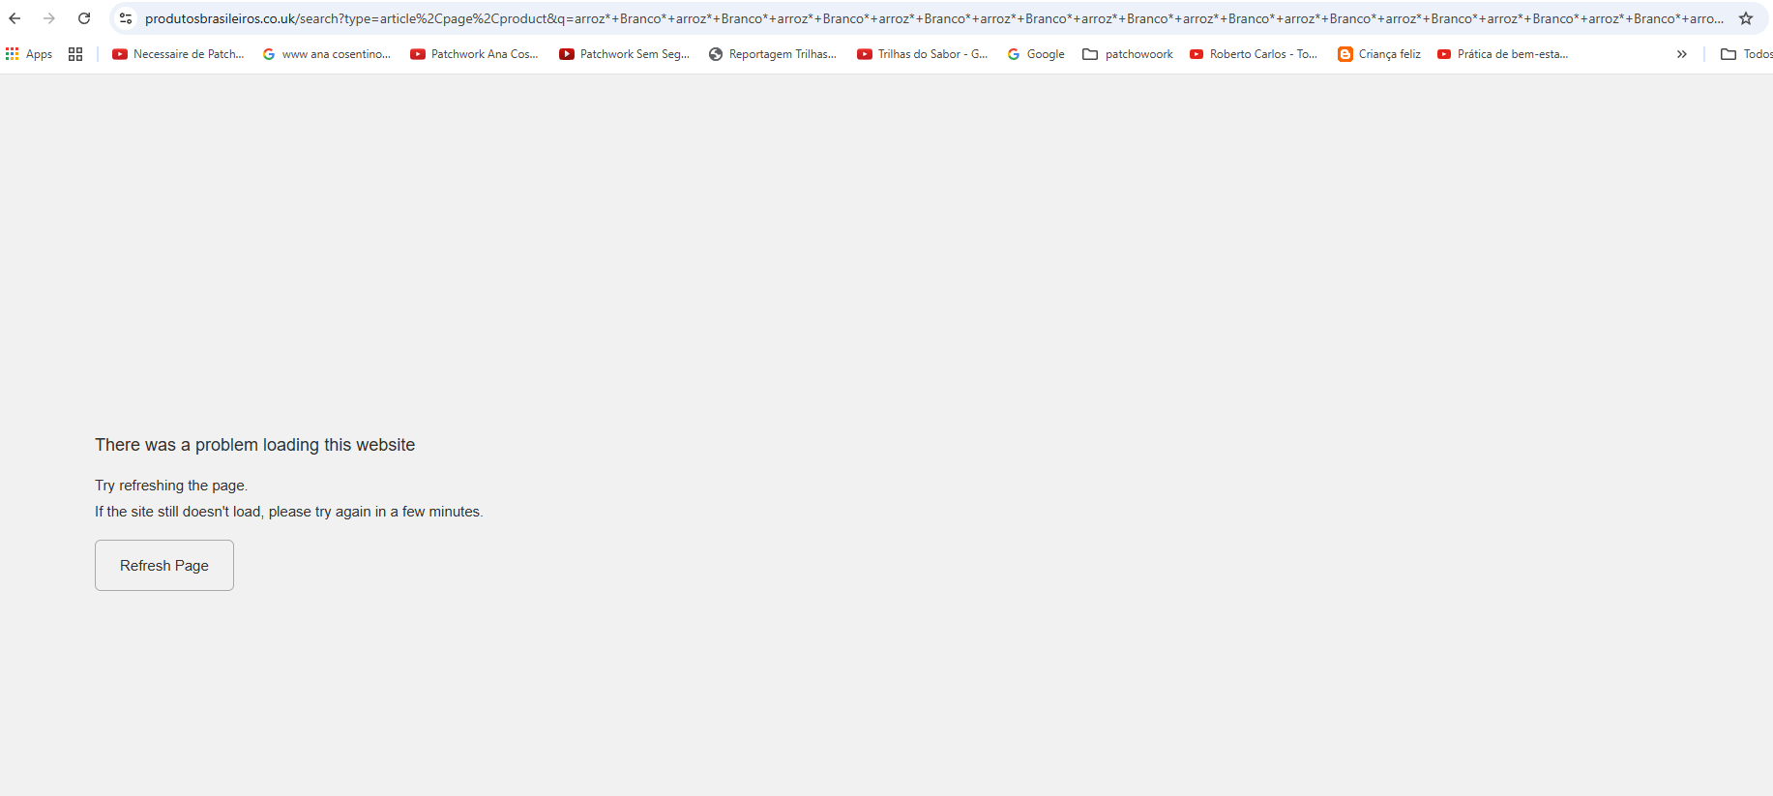
BUGS FOUND
The search field accepts an excessive amount of text. A search was performed with 1,314 words, resulting in an unknown error screen.

Slide 14
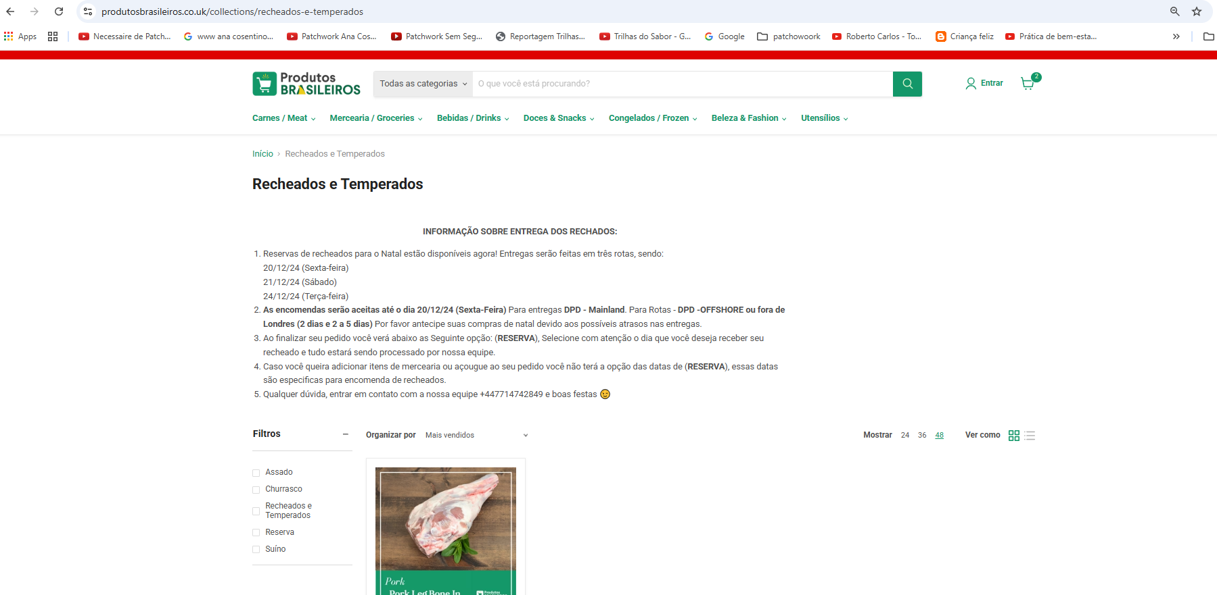
BUGS FOUND
Within the Utensils category in the menu bar there is an option for stuffed meats

Slide 15
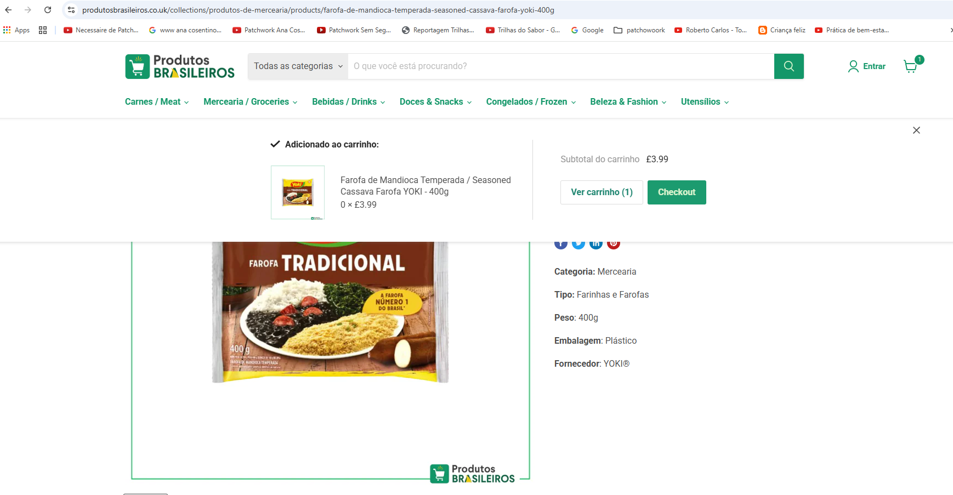
BUGS FOUND
If the cart has one item and you try to add one more with the quantity 0, it informs that it was inserted but does not update the quantity in the cart.

Slide 16
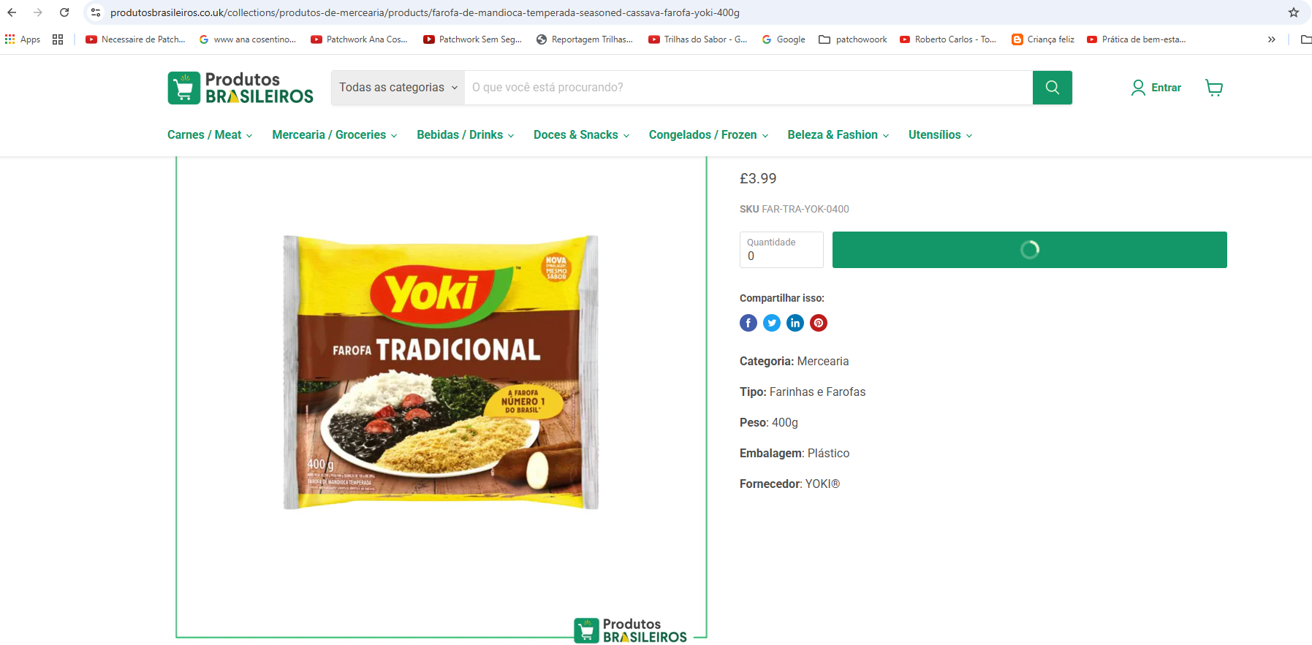
BUGS FOUND
When trying to put 0 of a product in the empty cart, the execution goes into infinite processing.

Slide 17
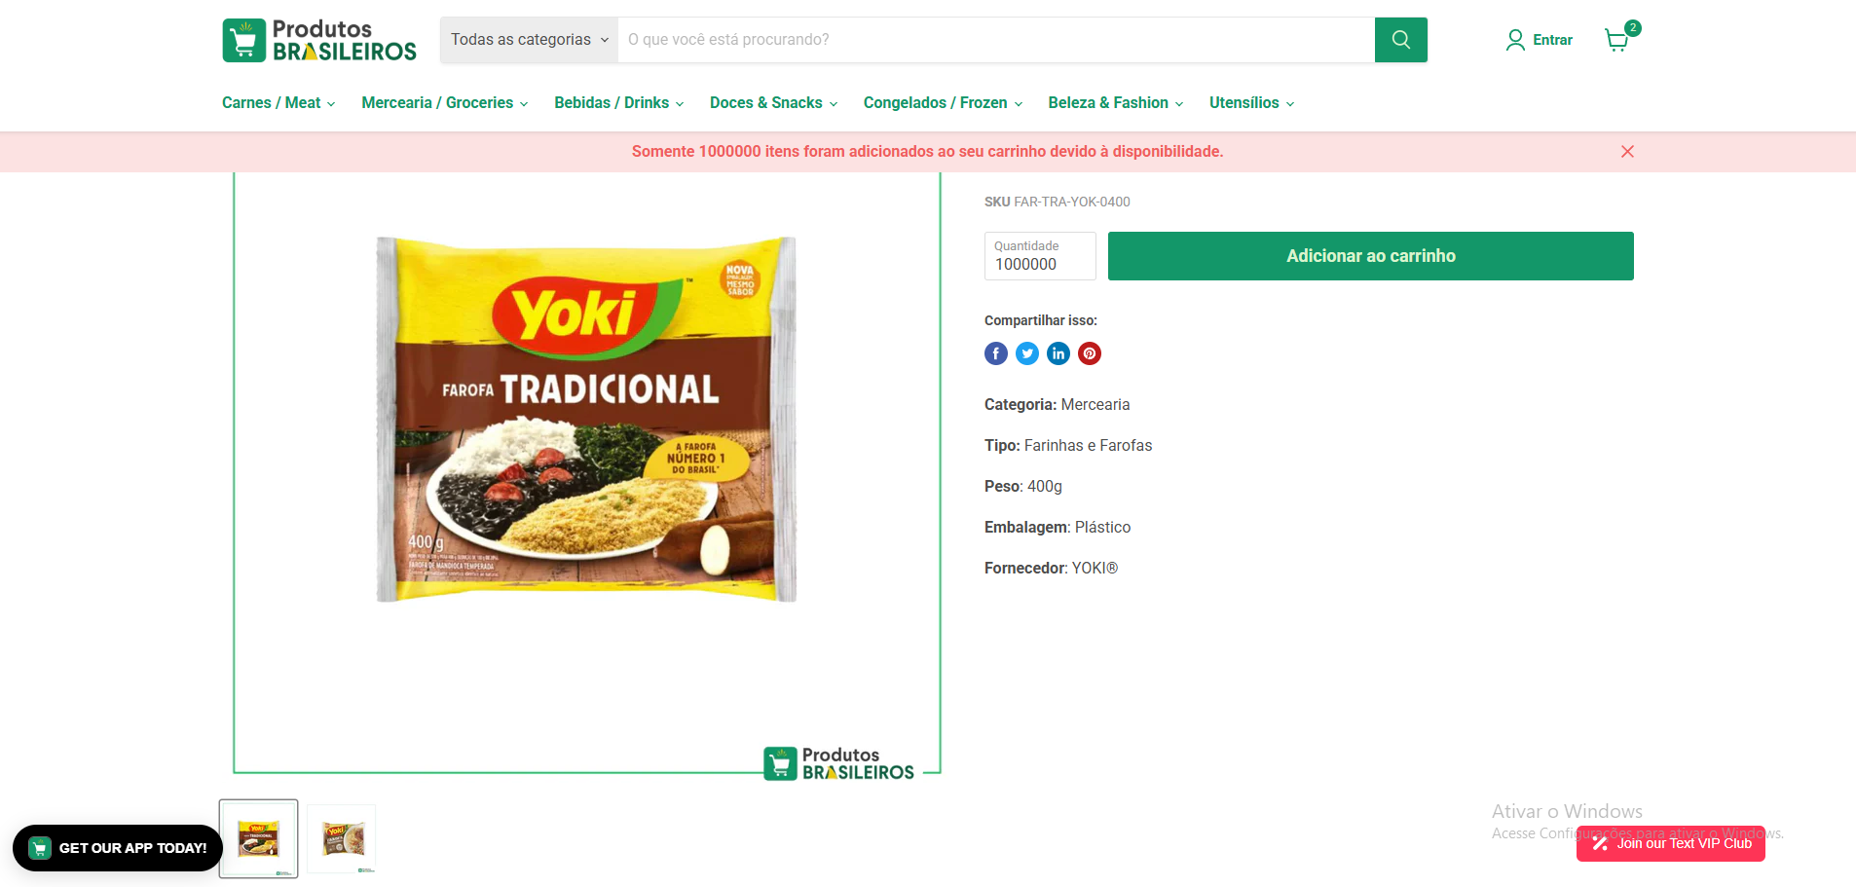
BUGS FOUND
Allows you to add 1 million items to your cart.

Slide 18
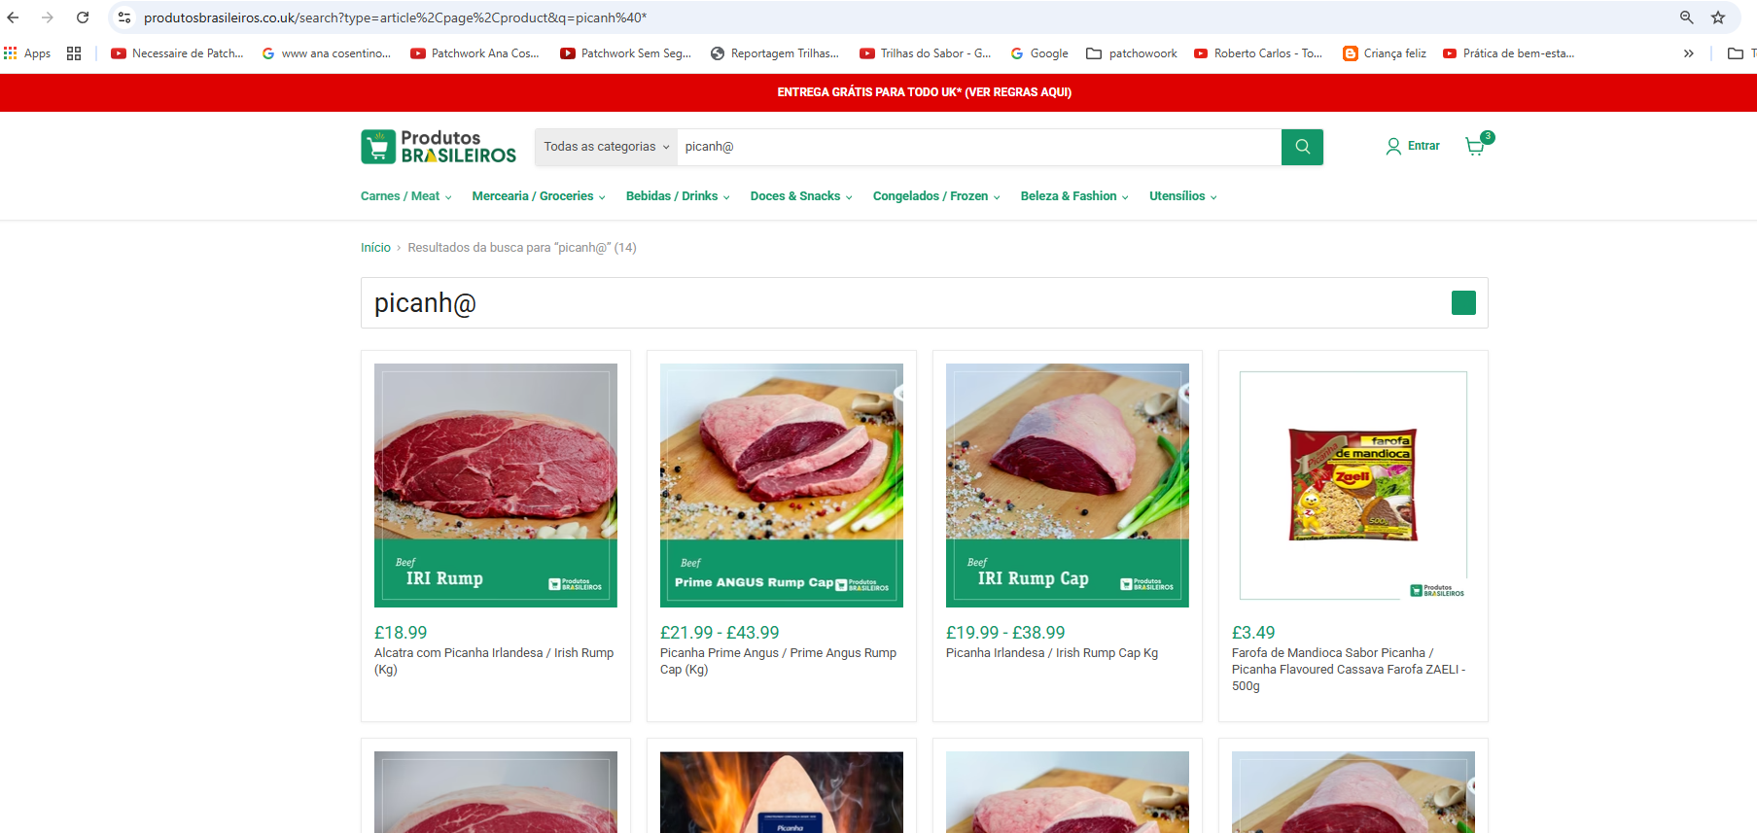
BUGS FOUND
A product name with a wrong character “picanh@”, still returns the product list.

Slide 19
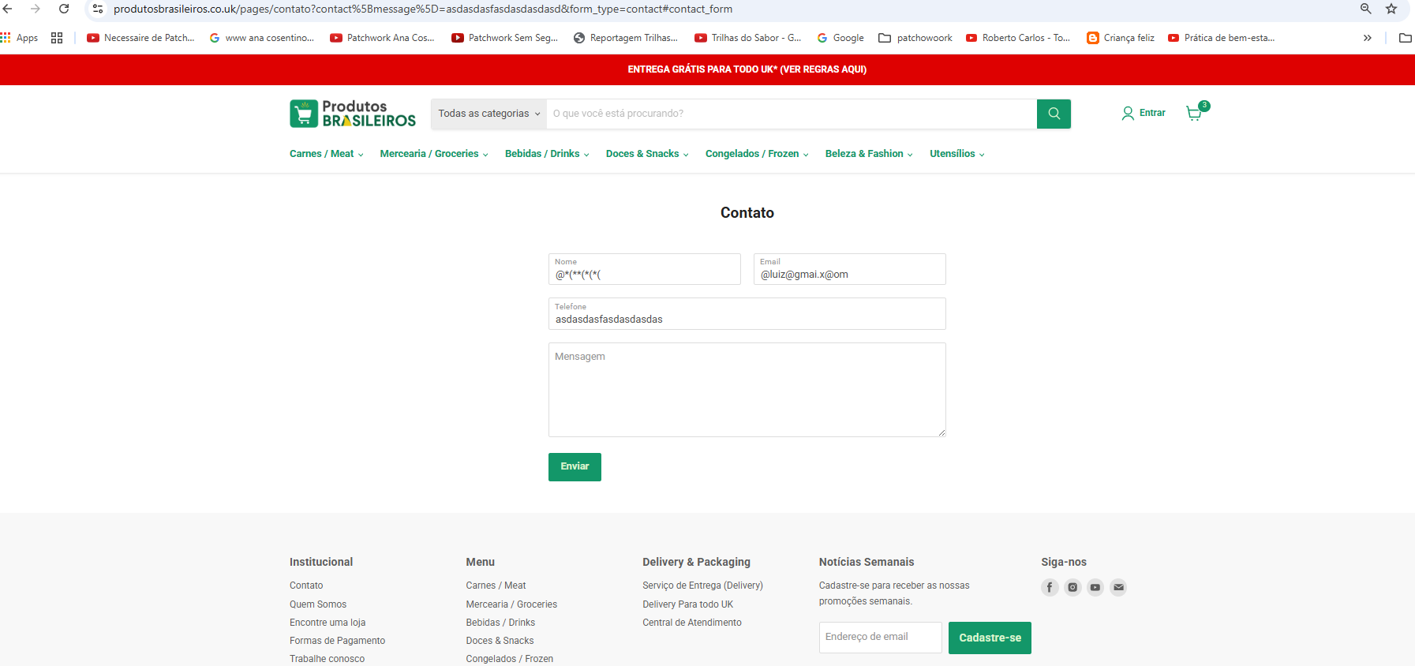
BUGS FOUND
Filling in all fields of the contact form with invalid values ​​does not return any error.

Slide 20
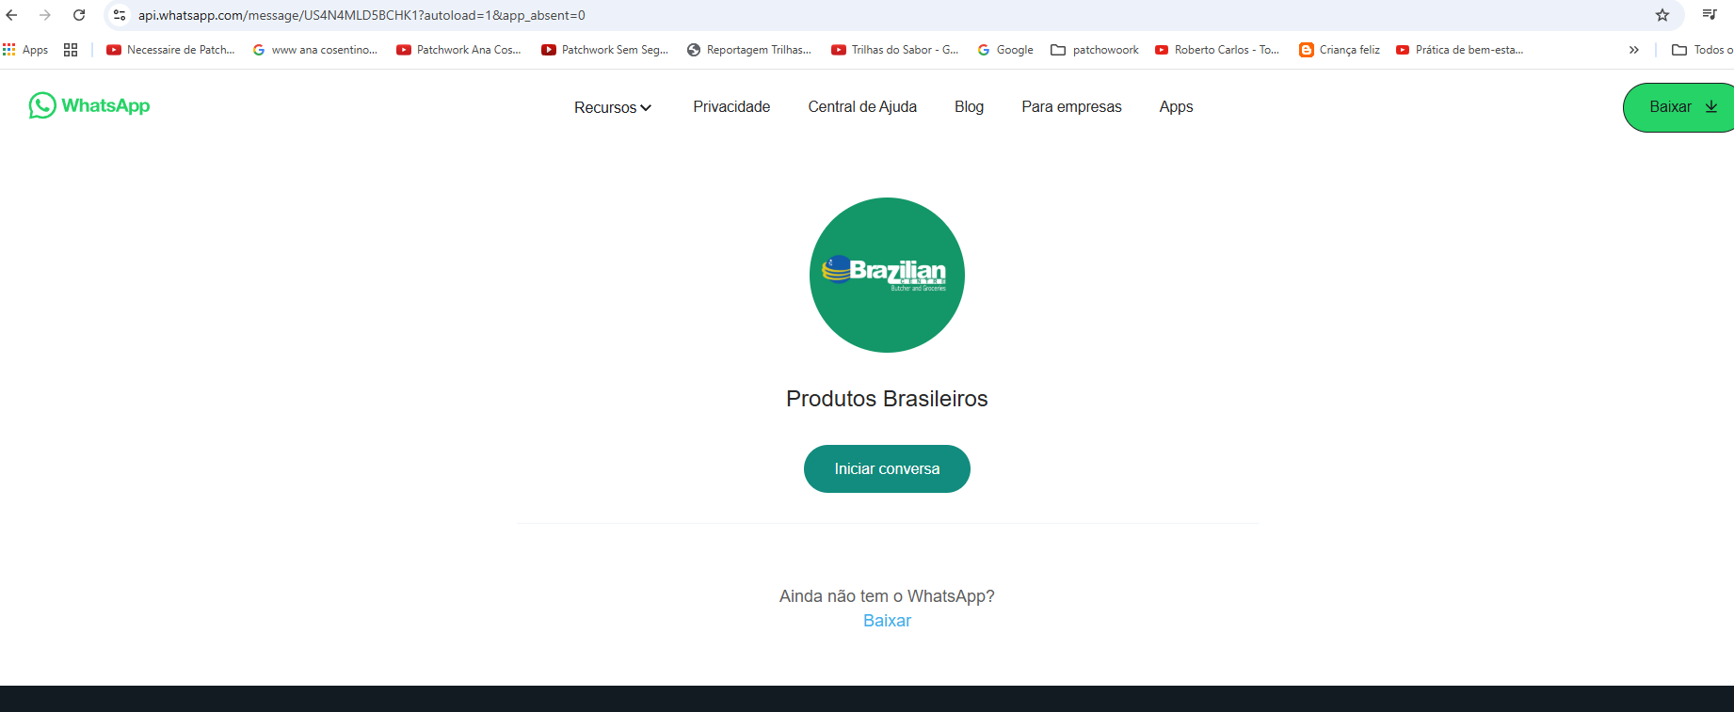
BUGS FOUND
The button "Pergunte pelo WhatsApp" on the homepage leads to WhatsApp Web, but it doesn't open in a new tab or window, it opens in the same tab as the website. I think this is bad because people generally want to continue viewing the site to ask questions about it.

Slide 21
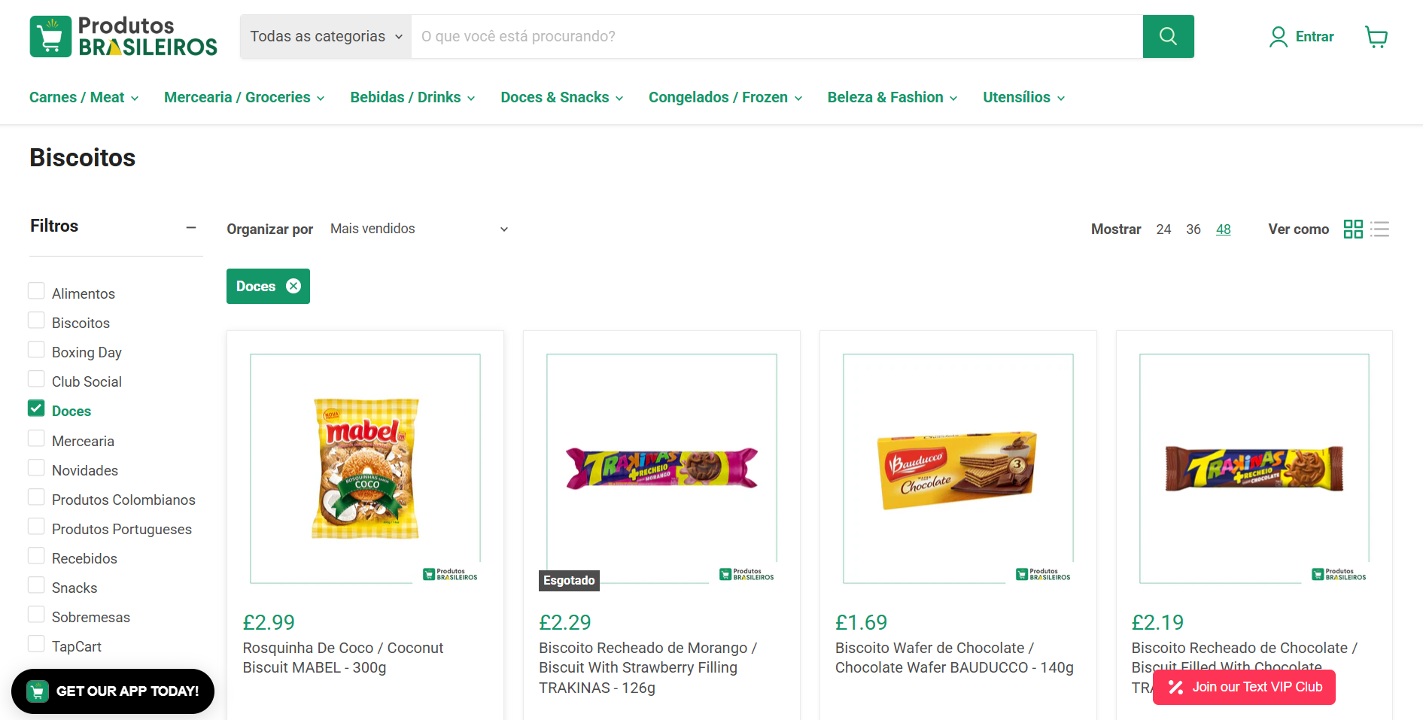
BUGS FOUND
In “Filters” it’s not possible to select multiple products, only one at a time.

Slide 22
FINAL CONSIDERATIONS
This project helped us understand how Generative AI can be used to test real online systems in a practical way. By following testing principles from James Bach, we focused on finding real problems that users could face.
Through structured tests, we identified several bugs and the product risks related to them. These issues could affect user experience, system performance, and business operations.

Slide 23
FINAL CONSIDERATIONS
Based on real tests performed, the following product risks were found:
1. System Crash Risk
Caused by: Search field accepting excessively long input (1,314 words).
Impact: Unknown error screen and possible backend failure.

Slide 24
FINAL CONSIDERATIONS
2. Navigation Confusion
Caused by: Wrong category ("Stuffed meats" under "Utensils").
Impact: Poor user experience and decreased product visibility.
3. Cart Inconsistency
Caused by: Adding 0 quantity updates cart incorrectly.
Impact: Incorrect orders and customer frustration.

Slide 25
FINAL CONSIDERATIONS
4. Infinite Processing
Caused by: Adding 0 quantity to empty cart.
Impact: Freezes system, leading to cart abandonment.
5. Performance Overload
Caused by: Allowing 1 million items in the cart.
Impact: Risk of crashing server and affecting all users.

Slide 26
FINAL CONSIDERATIONS
6. Weak Input Validation
Caused by: Search returns results for invalid characters (e.g., "picanh@").
Impact: Potential security vulnerabilities and irrelevant results.
7. Data Quality Issues
Caused by: Contact form accepts invalid inputs without error.
Impact: Poor CRM data and missed customer support opportunities.

Slide 27
REFERENCES
Instagram. (n.d.). Instagram post CEl4k96pLnK. Retrieved September 09, 2025, from https://www.instagram.com/p/CEl4k96pLnK/ DevMedia. (n.d.). Trabalhando com testes exploratórios. Retrieved September 09, 2025, from https://www.devmedia.com.br/trabalhando-com-testes-exploratorios/30528

Slide 28
THANK YOU!

